Slide 1
Entrepreneurship and E-Business
SEM-V-AY-2022-23
Prof. Shanta Sondur

Slide 2
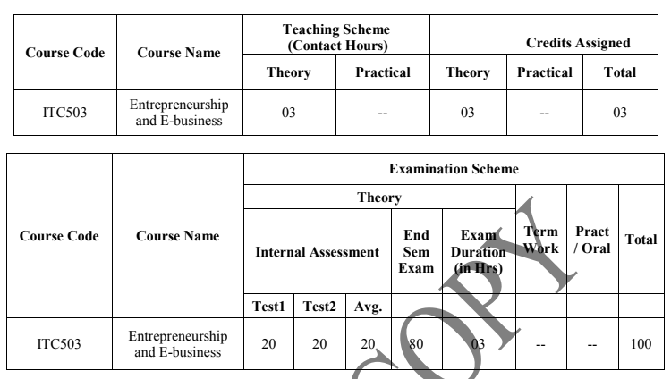
Syllabus

Slide 3
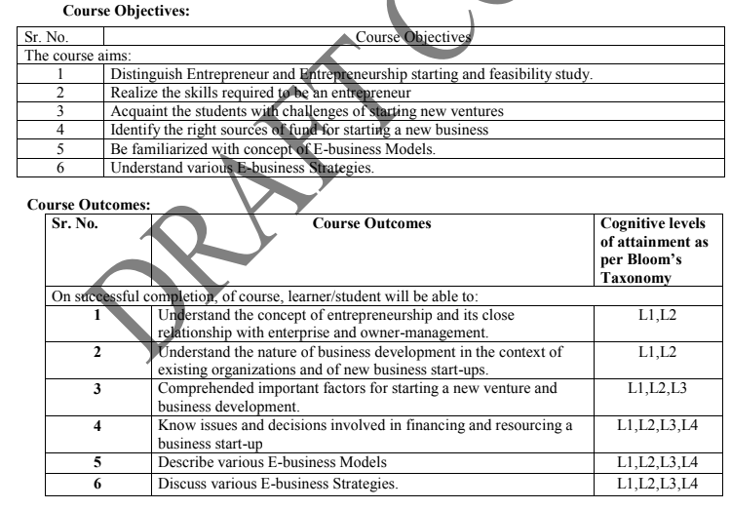

Slide 4
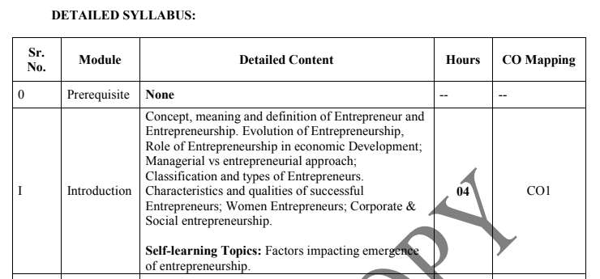
Module -1

Slide 5
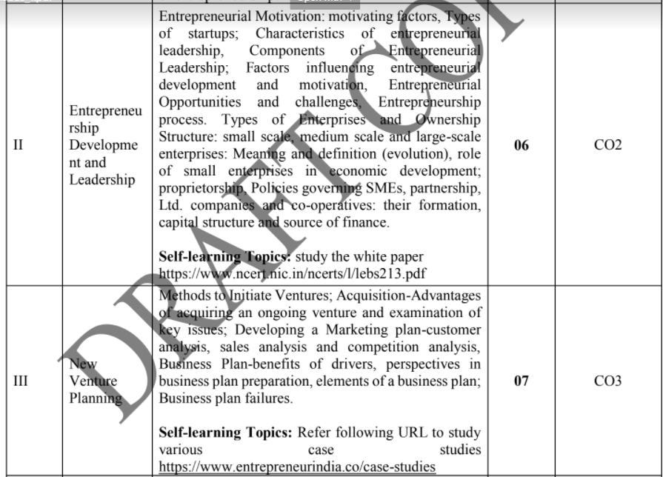
Module-2, 3

Slide 6
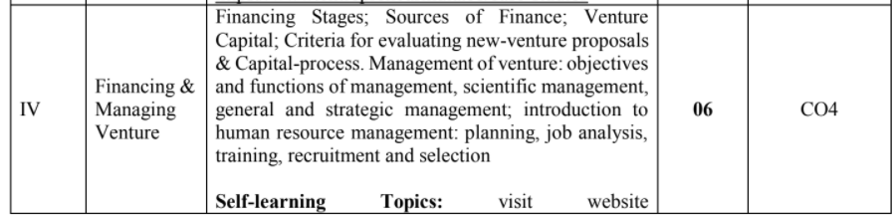
Module - 4

Slide 7
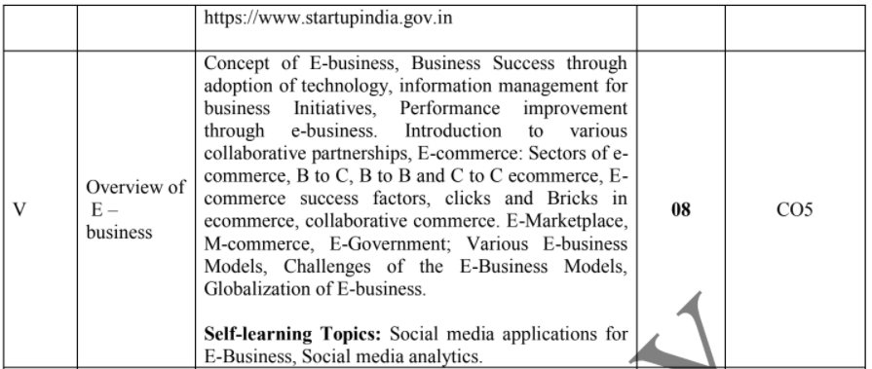
Module -5

Slide 8
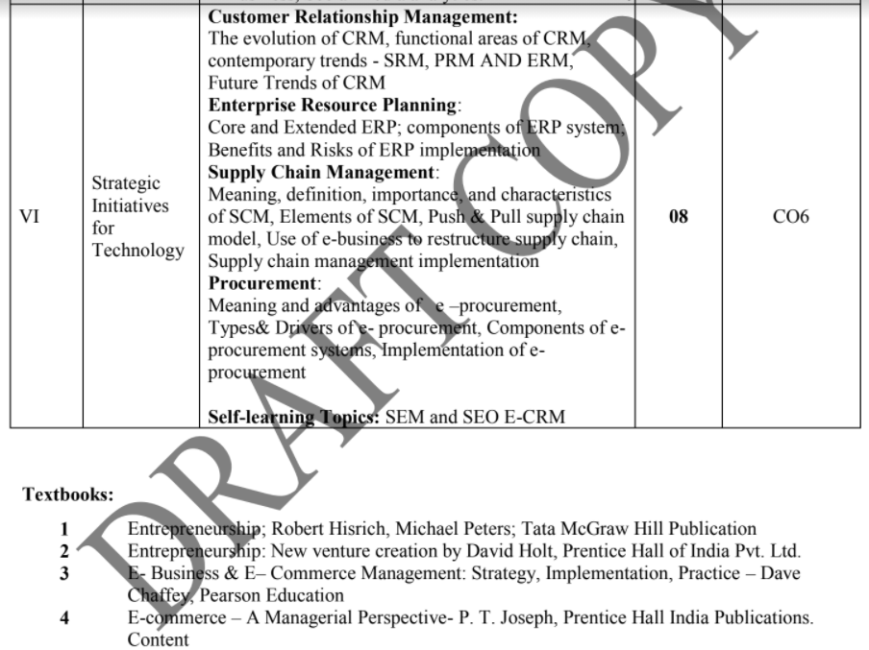
Module - 6

Slide 9
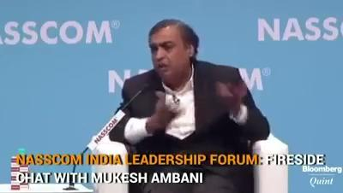

Slide 10

Ideas and Goals

Slide 11

IAS Officer’s inspiring story

Slide 12
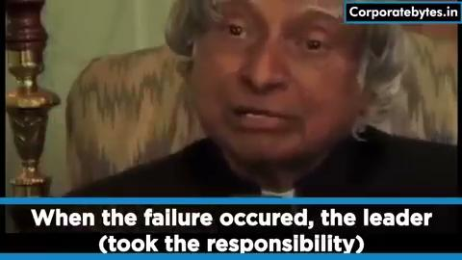
Rules of Success

Slide 14
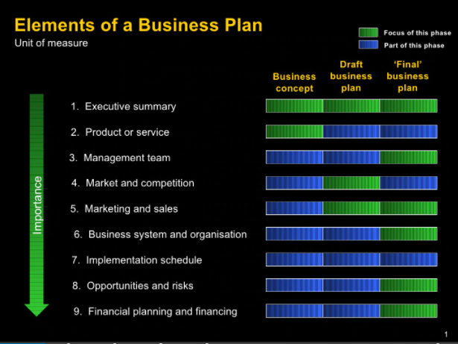
CA Scheme for EEB
Prepare the Start-up proposal based on the following points:

Slide 15
CA Scheme for EEB
Develop the E-commerce website for the above mentioned startup.
Few startup domains:
By Women entrepreneurs
Extending the Family Businesses
Product industry
Entrepreneurial approach towards Education
Service industry
etc

Slide 16
Rubrics for CA
Rubric 3 |  | R3-Marks | Rubric 5 | R5-Marks
Content beyond syllabus presentation - Prepare the Start-up project proposal |  | 10 - Split -up 2 - novelty in the proposal 2 - Market survey/competition 2 - financial survey/risk 2 - organization/team 2 - marketing/sell | Mini Project - Develop the E-commerce web site (minimum 5 functionalities - each carrying 2 marks) | 10 - each Functionality carries 2 marks

Slide 17
The entrepreneur
The entrepreneur word is derived from the French word Entreprendre which means to undertake,
i.e., the person who is ready to accept the challenges, risks, whatever will come to his way while starting a new business.
In early sixteenth century, the Frenchmen who organized and led military expeditions were referred to as entrepreneurs.
A French economist Richard Cantillon used the word entrepreneur for first time for business activities.

Slide 18
Definition of Entrepreneur
(i) According to Oxford Dictionary an entrepreneur is “A person who sets up a business or businesses, taking on financial risks in the hope of profit”
(ii) According to the International Encyclopedia, an entrepreneur is “An individual who bears the risk of operating a business in the face of uncertainty about the future conditions”.
(iii) Schumpeter’s Definition: (Joseph Alois Schumpeter was an Austrian political economist.)
“The entrepreneur, in an advanced economy is an individual who introduces something new in the economy
a method of production not yet tested by experience in the branch of manufacturing,
a product with which consumers are not yet familiar,
a new source of raw material or of new markets and the like”.

Slide 19
Definition of Entrepreneur
(iv) Adam Smith’s Definition: (Adam Smith FRSA was a Scottish economist, philosopher, moral philosopher, pioneer of political economy, and a key figure during the Scottish Enlightenment.)
“The entrepreneur is an individual, who forms an organization for commercial purpose. She/he is proprietary capitalist, a supplier of capital and at the same time a manager who intervenes between the labour and the consumer”.
“Entrepreneur is an employer, master, merchant but explicitly considered as a capitalist”
(v) Peter F. Drucker’s Views on Entrepreneur: (Peter Ferdinand Drucker was an Austrian-American management consultant, educator, and author, whose writings contributed to the philosophical and practical foundations of the modern business corporation)
“An entrepreneur is the one who always searches for change, responds to it and exploits it as an opportunity.
Innovation is the specific tool of entrepreneurs, the means by which they exploit changes as an opportunity for a different business or different service”.

Slide 20
Definition of Entrepreneur
(vi) Richard Cantillon’s Definition: (1680s – May 1734) was an Irish-French economist)
“A person who pays certain price for a product to resell it at an uncertain price thereby making decision about obtaining and using resources while assuming the risk of enterprise”.
(vii) According to W.B. Gartner in the Year 1985:
Entrepreneur is a person who started a new business where there was none before.

Slide 21
Cantillon
Cantillon- According to him, an entrepreneur is the agent who buys means of production at certain prices in order to combine them into a product that he is going to sell at prices that are uncertain at the moment at which he commits himself to his costs.
In this definition, Cantillon emphasised the function of risk taking and uncertainty bearing.
The entrepreneur is designated as a dealer who purchases the means of production or combining them into marketable products.

Slide 22
Say
J. B. Say- “ a French economist, has defined an entrepreneur as the economic agent who unites all means of production—land of one, the labour of another and the capital of yet another and thus produces a product. By selling the product in the market he pays rent of land, wages to labour, interest on capital and what remains is his profit.”
The above definition provides that an entrepreneur is an important agent of production who gets together other factors of production.
He further states that the entrepreneur shifts economic resources out of an area of lower productivity into an area of higher productivity and greater yield.

Slide 23
Schumpeter
Joseph. A. Schumpeter- He defined “entrepreneur as an individual who carries out new combines of means of production by which there occurs disequilibrium.”
According to Joseph Schumpeter, an entrepreneur is an innovator who brings economic development through new combinations of factors of production. Schumpeter also made a distinction between an innovator and inventor.
An inventor discovers new materials and methods while an innovator utilises these discoveries to make new combinations.
He further stated that the key individuals in development are the entrepreneurs, who are especially motivated and talented class of people.
They foresee the potentially profitable opportunity and try to exploit it.
According to him, entrepreneur is basically an innovator and innovator is one who introduces new combinations

Slide 24
Drucker
Peter F. Drucker- He observed that “Entrepreneurs innovate.
Innovation is the specific instrument of entrepreneurship.
It is the act that endows resources with a new capacity to create wealth.
Innovation, indeed creates a resource.”
According to Peter Drucker, successful entrepreneurs, whatever their individual motivation be it money, power, curiosity or the desire for fame and recognition, try to create value and to make a contribution.
Still, successful entrepreneurs aim high.
They are not content simply to improve an alternative what already exists or to modify it.

Slide 25
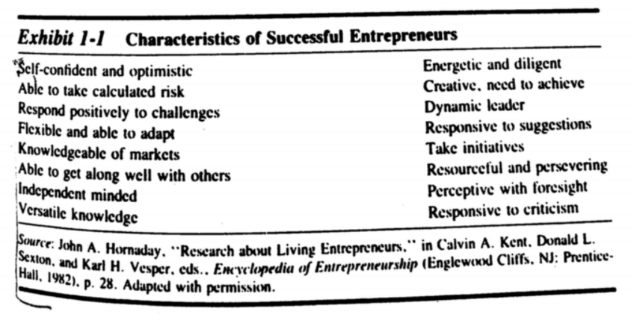

Slide 26
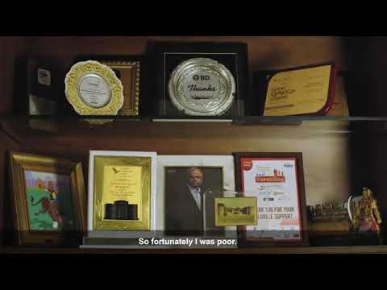
#Romance with #Risk - Story of #Thyrocare Founder Dr Velumani

Slide 27
Entrepreneurship
Entrepreneurship is
the attempt to create value through recognition of business opportunity,
the management of risk taking appropriate to the opportunity and
through the communicative and management skill to mobilize
human,
financial, and
managerial and
material resources necessary to bring project to fruition.
Entrepreneurship means
the function of seeing investment and production process,
raising capital,
hiring labour,
arranging the supply of raw materials,
finding site,
introducing a new technique and commodities,
discovering new sources of raw materials, and
selecting top managers for day-to-day operations of the enterprise.

Slide 28
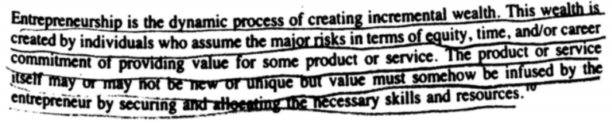
Entrepreneurship

Slide 29
Entrepreneurship
A.H. Cole defined entrepreneurship as the
purposeful activity of an individual or a group-associated individuals undertaken to initiate, maintain or aggrandize a profit oriented business unit for the production or distribution of economic goals and services.
According to Frederick Harbinson, entrepreneurship is the skill to build an organization.
Pathak regarded the term entrepreneurship as co-extensive with setting up and managing a small scale unit. This involves a wide range of areas needing a series of decisions that can be broadly grouped into three categories – Decisions related to-
Perception of an opportunity,
Organization of an industrial unit, and
Running of the industrial unit as a profitable, going, and growing concern.

Slide 30
Entrepreneurship
Robert Ronstadt presented the essence of entrepreneurship in the following way –
Entrepreneurship is the dynamic process of creating incremental wealth.
This wealth is created by individuals who assume major risks in terms of
equity,
time, and/or
career commitment of providing value for some product or service.
The product or service itself may not be new or unique but the value must be.

Slide 31
Process of entrepreneurship
The Entrepreneurship Process can be expressed as
a set of procedures and methodologies, followed by entrepreneurs to establish a new business or venture.
All the entrepreneurship process phases have certain meanings and functionality, which one has to trail and pursue for setting up a venture.

Slide 32
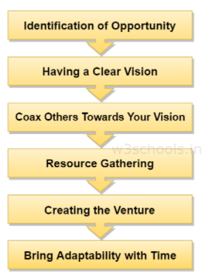
Flow diagram of the different phases of the Entrepreneurship process

Slide 33
Identification of opportunity
ID fresh food, KFC, bookmynanny, Swiggy, Swiggy Go, Zomato Gro.,
Pink Auto - initiative by govt. http://www.bookmynanny.in/services.php
At the very early stage, an entrepreneur has to detect a problem in society and sense out some opportunities and visualize the market or consumer ratio.
His/her creativity and innovation will also bring challenges.
Entrepreneurs should look for the scope to find an alternate efficient solution for needs, wants, detecting issues and problems, and effective solutions.
If you're opting for the solution and you as an entrepreneur is standing in the very front, then you are on the advantageous side, which provides product identification and top reliability in the market.

Slide 34
2. Having a clear vision
There is a say - "A vision without implementation is just a dream with closed eyes."
Another phase that the entrepreneur must have to see while creating his empire is to look beyond the idea or plan.
He/she has to have a vision from the experience and a creative mindset to come up with new and innovative methodologies for solving different problems.
Let suppose; Mark Zuckerberg came up with the plan to connect the whole world socially + digitally.
But his ideas didn't stop by just creating the popular social networking site - Facebook.

Slide 35
3. Coax others towards your vision
After having a clear vision and planning tactic in mind, an entrepreneur has to form a team with different skill-sets who will work together to make the vision a reality.
As an entrepreneur, he/she has to persuade all those individuals (partners, family members, financiers, employees) towards the same goals and motives.

Slide 36
4. Resource Gathering
In this phase, an entrepreneur has to come up with a strong business plan and a powerful pitching capability to make your audience understand the potential in your idea.
Your business plan should also attract venture capitalists, investors, different financial institutions, partners, and promoters.
There is a separate topic discussing each of their roles in detail.
After getting financial support, the entrepreneur has to identify resources (which can be materials, office location, or workforce) to turn their ideas into a viable enterprise.

Slide 37
5. Creating the Venture
After all the resources are in the proper place and arranged, it is time to develop the venture and start running it successfully.
This requires most of the skills that an entrepreneur should possess (as discussed in the previous chapter).

Slide 38
6. Bring Adaptability with Time
It is essential to monitor and realize when the up-gradation is necessary for an organization.
Because if you do not keep bringing enhanced things on the table, someone else will take away the market and hence the profit. Ex - Kodak film
The entrepreneurs only have to think out of the box and adapt to the changing market conditions.
From the example of point (ii), Mark Zuckerberg's vision of connecting every individual socially through digital medium didn't end up by just creating Facebook.
He and his co-founders' team kept innovating the ideas and diving deep into other associated domains like Artificial Intelligence (AI) and Machine Learning (ML).
Hence, such algorithms run in the background to make connectivity and people's recommendations more productive and smart.

Slide 39
What is the Importance of Entrepreneurship in Economic Development?
Indian Economy has got a distinct identity.
The Economy of the country is supported by
the huge size of the population,
the considerable size of the area,
a wide variety of natural resource,
the existence of various productive sectors and
growing size of the market along with growing economic problems.
In such Economy, development of a sound industrial sector can play an important role for all-round development of a country.
The role of Entrepreneurship for economic development is very beneficial for our country.

Slide 40
1. Generates Employment-
Unemployment is growing at a rapid rate in developing countries, particularly the unemployment among educated people, is an acute problem of most of the developing countries. Under these circumstances, the Entrepreneurs play a vital role in getting employment for themselves as well as they create a number of jobs for many unemployed people. As time passes, these entrepreneurs grow manifold and provide direct and indirect employment to many more.
Hence. Entrepreneurship is the best solution to solve the social problem of unemployment.

Slide 41
2. Increases National Income-
National Income comprises of goods and services produced in a country in one year. The goods and services are produced to meet the requirements of our country as well as to meet the demand for exports.
The increased number of Entrepreneurs meet the domestic demand and export demand by producing goods and services in the desired quantities.
Therefore, an increase in goods and services helps in increasing the national income of a country increase in goods and services helps in increasing the national income of a country.
Increased employment will contribute to the generation of higher National Income.

Slide 42
3. Increases possibility for Dispersal of Economic Power-
Economic power is the natural outcome of Industrial and business activity.
Industrial development normally leads to concentration of economic power in few hands, which leads to Monopoly.
The conditions of monopoly in the country shall lead to a number of social and economic evils - like increase in price of the product and services and adamancy.. etc…
Hence the encouragement given by the Government to new Entrepreneurs to set up a large number of enterprises helps in weakening the harmful effects of monopoly.
When the concentration of Economic Power in few hands has been removed and wealth shared by a large number of Entrepreneurs, socialism can be promoted, and the Nation shall become economically wealthy.

Slide 43
4. Leads to Balanced Regional Growth-
The growth of Industry and Business leads to the development of a number of other areas such as transportation, health, education, insurance, warehousing etc. hence a rapid development of Entrepreneurship ensures a balanced regional development.
If the new Entrepreneurs grow at a faster rate in view of increasing completion, the surrounding areas are developed due to the spreading of entrepreneurial activities to other areas. Therefore, setting up enterprises in smaller towns which are away from big cities/towns helps in the development of backward regions also.
Also Read: Indian Economy On The Eve Of Independence (1947)

Slide 44
5. Provides better Standard of Living-
In any Economy, the people desire to get the goods and services in the required quantities at required places to satisfy their needs and wants.
The Entrepreneurial activities lead to the establishment of a micro, small, medium, and large scale enterprises in all regions of the country. The scarcity of essential commodities is removed with the initiation of entrepreneurial activities.
All the Entrepreneurs leads to improvement in the standard of living of the people. Hence providing goods and services in required quantities at a lower price, improves the purchasing power and standard of living of the people.

Slide 45
6. Role of Entrepreneurship in Economic Development is that it helps in the production of Qualitative Goods-
Entrepreneurial activities contribute much to the development of an economy. The increased Entrepreneurial undertakings ensure newer and qualitative products to the consumers, the Entrepreneurs in order to face the competition of the market and to satisfy the desires of consumers.
They concentrate on improved methods of production, quality of the product, reasonableness in price, effective distribution, etc. hence the quality of the product and services provided by the Entrepreneurs ensures the good health of the consumer.

Slide 46
7. Increasing Income Levels-
The increased Entrepreneurial activities lead to higher income levels and purchasing power of the people.
The Entrepreneur’s Industrial activities provide an increase in direct or indirect income levels to many people, the income levels of the people are increased
owing to the availability of goods at lower prices,
or generation of direct or indirect employment,
promotion of comforts,
the establishment of infrastructural facilities etc.

Slide 47
8. Helps in Exports-
The increased Entrepreneurial activities not only provide the required goods and services to the people, but it is also for expanding the surplus production of the Nation to other countries.
It means that the country shall become self-sufficient and can earn foreign exchange also with exporting of surplus goods and services.

Slide 48
9. Role of Entrepreneurship in Economic Development is that it generates Capital-
Increased Entrepreneurial activities help in generating scare capital.
The Entrepreneur acts as a middleman between investors and enterprise and raises capital from various sources.
The capital raised is used for setting up a new business for creating goods and services to satisfy the consumer needs and wants, the high growth rate of capital formation indicates the Economic development of a Country.

Slide 49
10. It enables effective Utilisation of Natural Resources-
A Country’s Economic development always depends on the Utilisation of its Natural Resources. Availability of natural resources differs from one region to other regions. When available resources such as climate, soil, rainfall, mineral mines, sources of power and gas etc. are effectively used, the economy is assured of rapid growth and development of a country.
11. It helps in the creation of Markets-
Entrepreneurial activities lead to increased production of goods and services.
This automatically leads to the creation of new markets and new customers for the new enterprise.
Thus, a new enterprise creates a new market for the goods and services and capture a market share in the business.

Slide 50
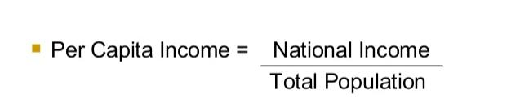
12. It enhances Per Capita income-
The per capita income of a country is equal to national income divided by its population. The availability of goods and services produced by Entrepreneurs leads to an increase in national income which in turn increases per capita income of the people.
The increased per capita income reflects the Economic Growth and Industrialization of an economy.
The formula for calculation of per capita income

Slide 51
13. It makes the country Self-reliant-
The Entrepreneurial activities of Entrepreneurs enable the country to be self-reliant. It reduces the dependence on imports and increases in exports.
Therefore, our country becomes self-reliant by producing goods and services required by society.
The reduced dependence on foreign countries and their produce indicates a strong balance of payments for our country.

Slide 52
14. Is that it leads to Innovations-
Entrepreneurial activities lead to employing resources on new ideas and innovations. The Entrepreneurs locate new ideas and put them into effect in the process of Economic Development.
The Entrepreneur is an innovator of new ideas of products and services.
They are capable of satisfying the dynamic needs of Society, like generating Employment Opportunities.
All these above-mentioned points are the main reason as to why Entrepreneurship is important for Economic Development.

Slide 53
Classification and types of Entrepreneurs.
Types of entrepreneur
Entrepreneurs are of various types. There are a lot of subcategories and many unknown categories as well. Since innovation has no limit and henceforth, the types might increase. But, to the base, there are some fixed categories of entrepreneurs. These are:
Entrepreneurs based on Ownership:
Public sector Entrepreneurs
Private sector Entrepreneurs
Entrepreneurs based on the mindset:
Empirical Entrepreneurs
Cognitive Entrepreneurs
Rational Entrepreneurs
Aggressive Entrepreneurs
Adoptive Entrepreneurs
Entrepreneurs based on enterprise-scale:
Large-scale entrepreneurs
Small scale Entrepreneurs
Entrepreneurs based on nature of entrepreneurship:
Gap Fillers
Risk bearers
Radical Innovators

Slide 54
Characteristics and qualities of successful Entrepreneurs;
Prime characteristics of an entrepreneur
Optimism: An entrepreneur has to have the mindset to explore various opportunities to put his idea into action.
Vision: One has to realize and act according to the market demand and focus on the socio-economic aspects and the future of the business he/she is planning to start.
Goal Setting: An entrepreneur must have some realistic goals to achieve.
Knowledge: An entrepreneur should have sound knowledge and understanding of what he is planning to do as well as have a broader view of business technicalities.
Independence: He/she has to work independently for decision making.
Desire to succeed: One has to plan goals so that he/she can seek productive opportunities.
Initiative taker: An entrepreneur has to take the firm initiative to make a plan work under limited resources (where the resource can be workforce or materials/goods).
Problem solver: One should have a creative mind in solving complex problems for society.
Good pitching power: One sound can pitch his idea in clear words and persuade others.
Sound human relation: An entrepreneur should have to be a good motivator, team-builder, and ultimately a leader.

Slide 55
Classification of Entrepreneurs
The entrepreneurs can be classified on the basis of:
1. Ownership
2. Personality Traits and their Style of Running the Business
3. Type of Business
4. Stages of Development
5. Clarence Danhof -Usually they are second-generation entrepreneur in a business family enterprise.
6. Use of Technology
7. Motivation
8. Growth
9. Stages of Development
10. Other Categories

Slide 56
1. Innovating Entrepreneurs 2. Imitating Entrepreneurs
3. Fabian Entrepreneurs 4. Drone Entrepreneurs
5. Spontaneous Entrepreneurs 6. Motivated Entrepreneurs
7. Induced Entrepreneurs 8. The Achiever
9. The Idea Generator 10. The Real Manager
11. The Real Achievers 12. Industrial Entrepreneur
13. Trading Entrepreneurs 14. Corporate Entrepreneur
15. Agricultural Entrepreneur 16. First Generation Entrepreneur
17. Modern Entrepreneur 18. Classical Entrepreneur
19. Individual and Institutional Entrepreneurs 20. Entrepreneurs by Inheritance
21. Technologist Entrepreneurs 22. Gender (Man/Woman Entrepreneur)
23. Educated/Uneducated Entrepreneur 24. Location (Urban/Rural Entrepreneur)
25. Local/Indian/Foreign Entrepreneur 26. Entrepreneurs by Inheritance
27. Technologist Entrepreneurs 28. Forced Entrepreneurs
29. Pure Entrepreneurs 30. Technical Entrepreneurs and a Few Others.

Slide 57
Based on the Type of Business:
1. Trading Entrepreneur:
As the name itself suggests, the trading entrepreneur undertake the trading activities.
They procure the finished products from the manufacturers and sell these to the customers directly or through a retailer.
These serve as the middlemen as wholesalers, dealers, and retailers between the manufacturers and customers.
2. Manufacturing Entrepreneur:
The manufacturing entrepreneurs manufacture products.
They identify the needs of the customers and, then, explore the resources and technology to be used to manufacture the products to satisfy the customers’ needs.
In other words, the manufacturing entrepreneurs convert raw materials into finished products.

Slide 58
3. Agricultural Entrepreneur:
https://www.thebetterindia.com/125477/kisan-diwas-successful-farmers-lucrative-business/
The entrepreneurs who undertake agricultural pursuits are called agricultural entrepreneurs.
They cover a wide spectrum of agricultural activities like cultivation, marketing of agricultural produce, irrigation, mechanization, and technology.
4. Corporate Entrepreneurs:
These entrepreneurs promote and establish corporate empires. They are successful at initiating and running corporate companies

Slide 59
Based on the Use of Technology:
1. Technical Entrepreneur:
The entrepreneurs who establish and run science and technology-based industries are called ‘technical entrepreneurs.’
Speaking alternatively, these are the entrepreneurs who make use of science and technology in their enterprises.
Expectedly, they use new and innovative methods of production in their enterprises.
2. Non-Technical Entrepreneur: https://espeo.eu/blog/non-technical-tech-startups-ceos/
Based on the use of technology, the entrepreneurs who are not technical entrepreneurs are non-technical entrepreneurs.
The forte of their enterprises is not science and technology.
They are concerned with the use of alternative and imitative methods of marketing and distribution strategies to make their business survive and thrive in the competitive market.

Slide 60
Based on Ownership:
1. Private Entrepreneur:
A private entrepreneur is one who as an individual sets up a business enterprise. He / she it’s the sole owner of the enterprise and bears the entire risk involved in it.
2. State Entrepreneur:
When the trading or industrial venture is undertaken by the State or the Government, it is called ‘state entrepreneur.’
3. Joint Entrepreneurs:
When a private entrepreneur and the Government jointly run a business enterprise, it is called ‘joint entrepreneurs.’

Slide 61
Based on Gender:
1. Men Entrepreneurs:
When business enterprises are owned, managed, and controlled by men, these are called ‘men entrepreneurs.’
2. Women Entrepreneurs:
Women entrepreneurs are defined as the enterprises owned and controlled by a woman or women having a minimum financial interest of 51 per cent of the capital and giving at least 51 per cent of employment generated in the enterprises to women.

Slide 62
Based on the Size of Enterprise:
1. Small-Scale Entrepreneur:
An entrepreneur who has made investment in plant and machinery up to Rs 1.00 crore is called ‘small-scale entrepreneur.’
2. Medium-Scale Entrepreneur:
The entrepreneur who has made investment in plant and machinery above Rs 1.00 crore but below Rs 5.00 crore is called ‘medium-scale entrepreneur.’
3. Large-Scale entrepreneur:
The entrepreneur who has made investment in plant and machinery more than Rs 5.00 crore is called ‘large-scale entrepreneur.’

Slide 63
Based on Clarence Danhof Classification:
Clarence Danhof (1949), on the basis of his study of the American Agriculture, classified entrepreneurs in the manner that at the initial stage of economic development, entrepreneurs have less initiative and drive and as economic development proceeds, they become more innovative and enthusiastic.
Based on this, he classified entrepreneurs into four types:
1. Innovating Entrepreneurs: https://www.seattlebusinessmag.com/article/top-25-innovators-entrepreneurs
Innovating entrepreneurs are one who introduce new goods, inaugurate new method of production, discover new market and reorganise the enterprise.
It is important to note that such entrepreneurs can work only when a certain level of development is already achieved, and people look forward to change and improvement.

Slide 64
Based on Clarence Danhof Classification:
2. Imitative Entrepreneurs: https://www.cnbc.com/2017/10/03/7-businesses-that-cloned-others-and-made-millions.html
These are characterised by readiness to adopt successful innovations inaugurated by innovating entrepreneurs.
Imitative entrepreneurs do not innovate the changes themselves, they only imitate techniques and technology innovated by others.
Such types of entrepreneurs are particularly suitable for the underdeveloped regions for bringing a mushroom drive of imitation of new combinations of factors of production already available in developed regions.
3. Fabian Entrepreneurs: Ex: Kodak
Fabian entrepreneurs are characterised by very great caution and skepticism in experimenting any change in their enterprises.
They imitate only when it becomes perfectly clear that failure to do so would result in a loss of the relative position in the enterprise.
4. Drone Entrepreneurs: Example - Citycell - Bangladesh co,
These are characterised by a refusal to adopt opportunities to make changes in production formulae even at the cost of severely reduced returns relative to other like producers.
Such entrepreneurs may even suffer from losses but they are not ready to make changes in their existing production methods.

Slide 65
Arthur Harrison. Cole Classification:
Actually, Arthur H. Cole had divided the history of American entrepreneurship into three stages of entrepreneurial thought process – Empirical stage (from scratch to 1860), Rational stage (1860-1890) and Cognitive stage (from 1890 onwards).
Accordingly, entrepreneurs can be classified into three broad categories:
(a) Empirical –
This category of entrepreneurs rarely introduce anything radical, innovative or revolutionary.
They are guided by the principle of rule of thumb.
(b) Rational –
The rational entrepreneurs have the information and are aware about the business environment.
They understand the prevailing economic conditions and are ready to introduce modifications when necessary.
(c) Cognitive –
Cognitive entrepreneurs are sophisticated.
They have experts to advise them and acts upon accordingly.
They introduce changes whenever necessary .
These changes may completely break from the existing scheme of enterprise.

Slide 66
Corporate Social Entrepreneurship (CSE)
Corporate Social Entrepreneurship (CSE) is a process aimed at enabling business to develop more advanced and powerful forms of Corporate Social Responsibility (CSR).
CSE emerges from and builds on three other conceptual frameworks:
entrepreneurship,
corporate entrepreneurship, and
social entrepreneurship.
The fundamental purpose of CSE is to accelerate companies’ organizational transformation into more powerful generators of societal betterment.
CSE integrates and builds on the foregoing concepts and has been defined by Austin, Leonard, Reficco, and Wei-Skillern (2006) as
“the process of extending the firm’s domain of competence and corresponding opportunity set through innovative leveraging of resources, both within and outside its direct control, aimed at the simultaneous creation of economic and social value.”

Slide 67
Key Elements of CSE
CSE aims to produce a significant and comprehensive transformation of the way a company operates.
The following elements are central to that process:
creating an enabling environment,
fostering corporate social intrapreneurs,
amplifying corporate purpose and values,
Generating double value, building strategic alliances

Slide 68
Enabling Environment.
For companies to move from their old approach to CSR to the CSE approach they must adopt an entrepreneurial mindset and cultivate an entrepreneurial environment that enables fundamental organizational transformation.
This can only happen if top leadership champions the change.
This requires a powerful vision of where the CSR revolution is taking the company and why it is vital to the organization’s success.
Orin Smith, former President and CEO, Starbucks Coffee Company expressed it this way, “Aligning self-interest to social responsibility is the most powerful way to sustaining a company’s success.”

Slide 69
The Corporate Social Intrapreneur.
The CSE process is powered by multiple change agents or Intrapreneurs.
Social and corporate entrepreneurship differentiate the roles of the social or corporate entrepreneur from the role of managers.
Both are distinct and usually sequenced:

Slide 70
Corporate Purpose: values-based organizations.
One of the key focal points of CSE is company values.
Getting organizational values right is vital to advancing CSR.
The CS Intrapreneurs need to ensure that social value generation – fulfilling social responsibilities – is seen as an essential component in companies’ mission and values statements.
The CSE process aims to ensure that the words are translated into action.
The values-based organizations see themselves as
trustworthy, moral agents, capable of generating trust based on sustained ethical behavior and innovative solutions to social problems.
Their goal is not just to comply with the law, or to be responsive to key stakeholders: they seek to lead through example, to exceed expectations, and to set new standards.
In these organizations, social values are not viewed as a shiny patina meant to embellish the “real” company, but rather as a structural component, a cornerstone of their organizational identities.

Slide 71
Value Creation and The Double Return.
Entrepreneurship is all about finding innovative ways to create value.
CSE aims to ensure that the very purpose of these corporations migrates from one of maximizing returns to investors to optimizing returns to stakeholders, with those being defined as groups who are significantly affected by company actions and who can in turn impact the company.

Slide 72
The analysis that follows is based first on an in-depth qualitative study of two companies that were
considered to be pioneers in the practice of CSE:
The Timberland Company (Austin, Leonard, and Quinn 2004; Austin, Leonard, and Quinn 2006), maker of outdoor apparel and accessories, and
Starbucks Coffee, a prominent specialty coffee company (Austin and Reavis 2002; Austin, Wei-
Skillern, and Gendron 2004).
These studies were supplemented with a review of practices of dozens of other companies
Top 10 Indian CSR cos.
https://www.youtube.com/watch?v=J4bmZJ1X5hk
CSR as a LAW in India - https://www.youtube.com/watch?v=JjOw31D5pDo
https://www.youtube.com/watch?v=w69sEZgS4sk
What is CSR?
https://www.youtube.com/watch?v=1bpf_sHebLI
Tata -
https://www.youtube.com/watch?v=CYvLyhlR6CY
https://www.mbaknol.com/management-case-studies/case-study-corporate-social-responsibility-of-starbucks/
Lego - https://www.youtube.com/watch?v=QkH13mO0uog
Google - challenges as well - https://www.youtube.com/watch?v=H3Afjmi2iqk

Slide 73
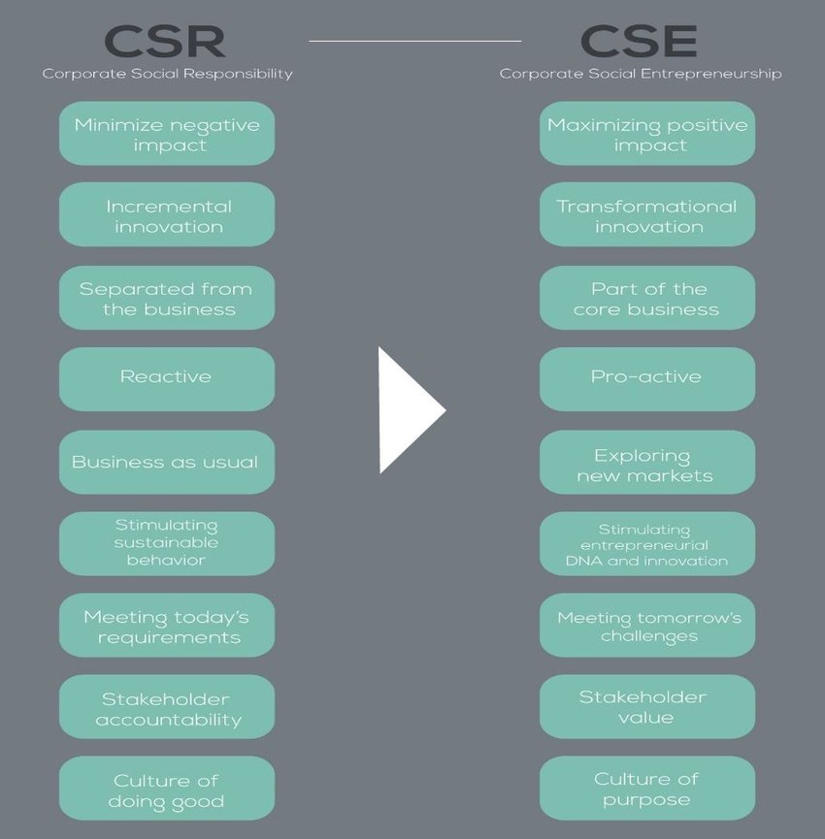

Slide 74
Timberland, in a fundamental move, formulated a set of values - “humanity, humility, integrity, and excellence” - that held the company and its people should make a positive difference in society and that its culture should foster involvement in confronting and solving social problems.
A Timberland Human Resources manager noted, “The awareness of values is what we are trying to raise with folks. It’s no longer going to be acceptable just to get the business result.”

Slide 75
This amplified purpose means that the company is
producing both economic and social value, which some have referred to as a double or triple (if
one breaks out environmental value as a separate category) bottom line, or “blended value”
(Emerson 2000, 2003, March 2006; Emerson and Bonini 2003). The important purpose of CSE
is to discover ways make these returns complementary and synergistic rather than competing
(Paine 2003). In this approach organizations’ social value creation is not treated as something
separate or peripheral. On the contrary, it is imbedded in a larger and transparent accountability
system that reports performance to the internal and external stakeholders. We are witnessing
the emergence of a multitude of such indicators, standards, and codes. The CSE approach aims
to ensure that these measures of performance have parity with the traditional ones and become
part of the corporate DNA.

Slide 76
Co-generating Value.
A vital part of the value generating strategies is collaborating with other
organizations – businesses, civil society, or governmental. These alliances are the vehicles for
achieving what the CSE definition referred to as extending the firm’s domain of competence and
corresponding opportunity set through innovative leveraging of resources outside its direct
control.

Slide 77
In the words of Sue Mecklenburg, Starbucks Vice President of Business Practices, partnerships
allows the company “to extend our reach to areas where we have interests, but perhaps not
influence or expertise. It's a real extension of what we can do, and often what we would like to do,
or what our customers expect us to do --issues that are very complex and difficult to solve.”
Starbucks entered into a partnership with Conservation International to foster environmentally
sustainable coffee production among small farmers in Chiapas, Mexico. This nonprofit brought to
partnership its environmental expertise and its capacity to work with small farmers. Starbucks
contributed it knowledge of quality coffee production and its marketing channels. This
entrepreneurial combination of distinctive competencies created a process that developed new
production techniques and new supply of organic coffee for Starbucks, which in turn generated
significant income enhancements to the farmers and improved environmental conditions in the
growing areas. This initial partnership expanded to other countries and even led to the
reformulation of Starbucks’ basic coffee procurement criteria and procedures

